Slide 1
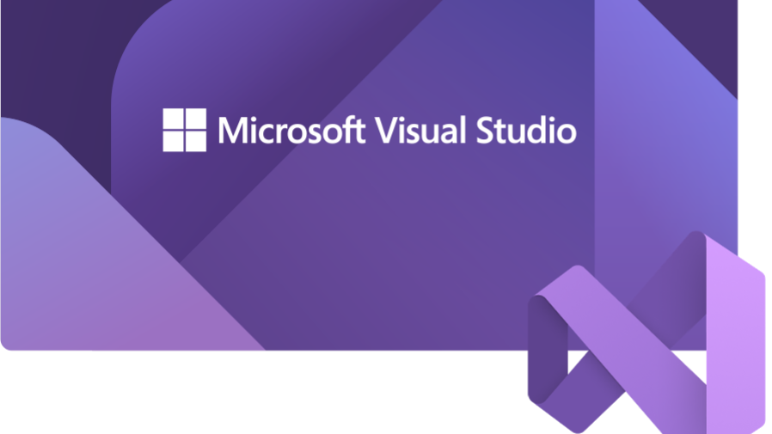

Slide 2
What is Visual Studio?
To develop any type of app or learn a language
Compilers
Code completion tools
Source control
extensions
Many more features
2

Slide 3
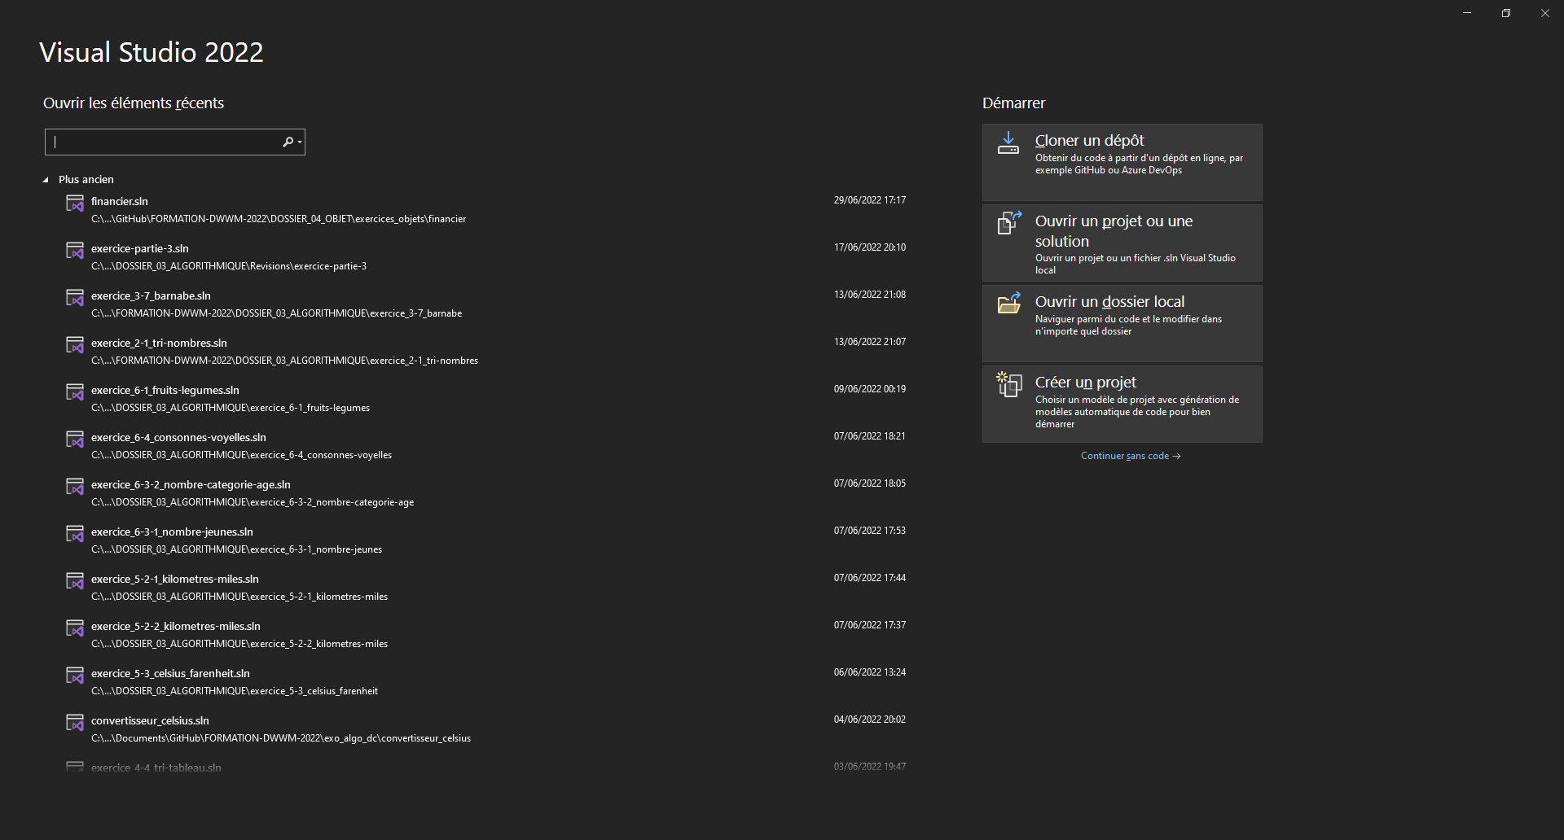
3

Slide 4
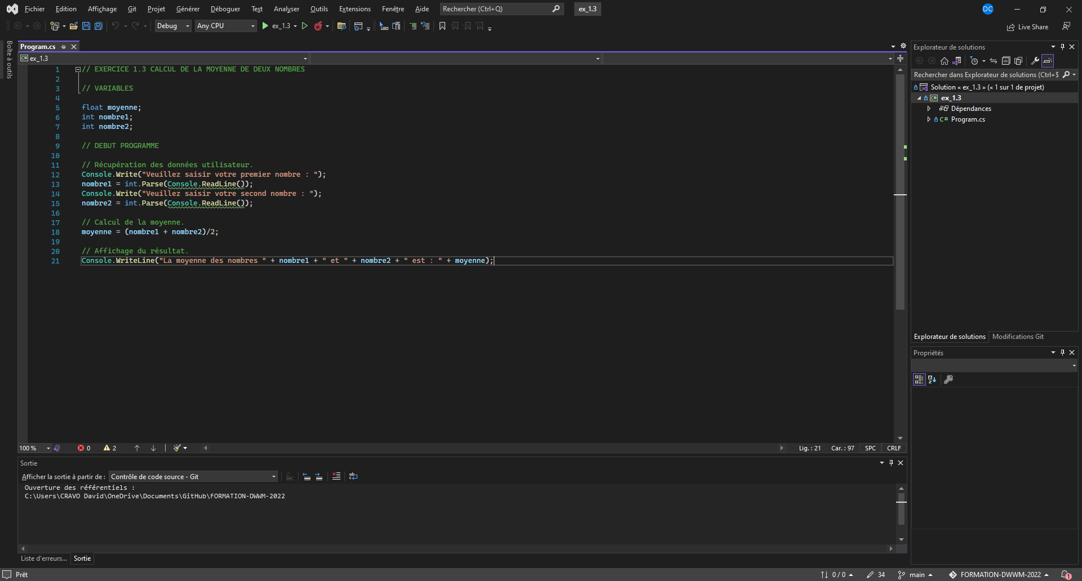
4

Slide 5
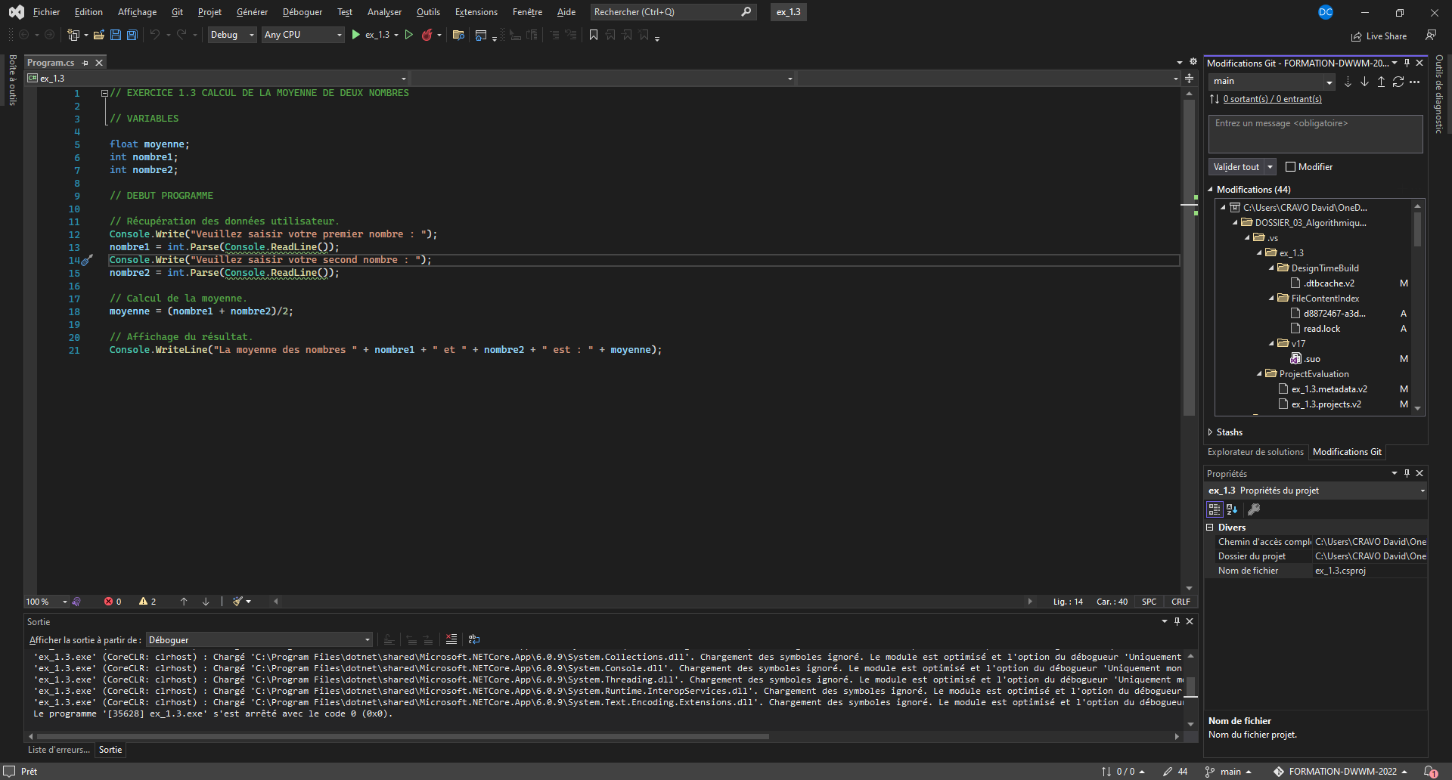
5

Slide 6
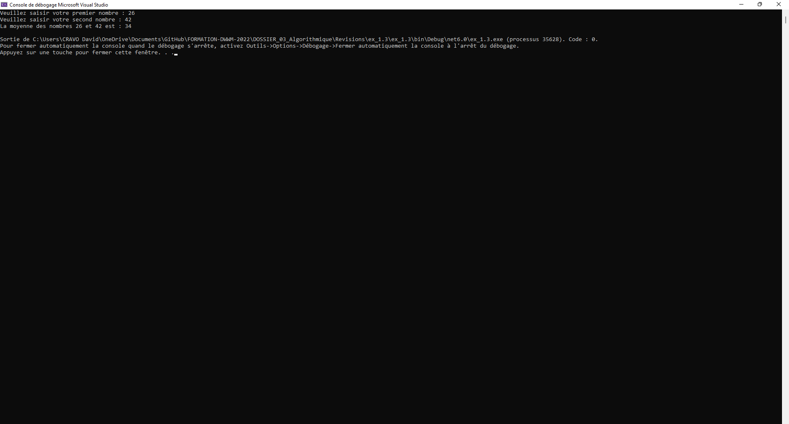
6

